Slide 1

The Effects of Cannabis and Alcohol on Driving Performance, and the Detection of Impairment
Thomas D. Marcotte, PhD
Robert Fitzgerald, PhD
Center for Medicinal Cannabis Research (CMCR)
University of California, San Diego

Slide 2
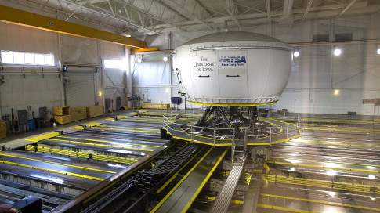
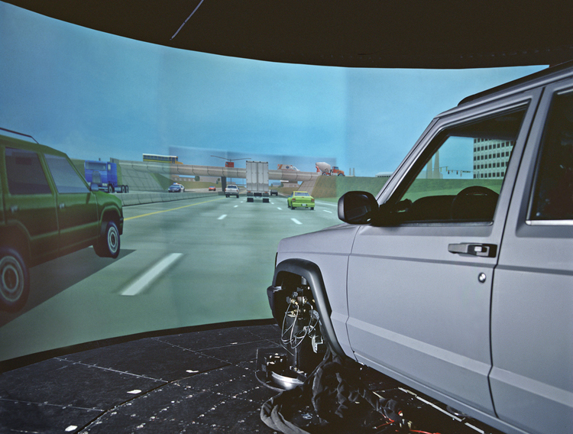
National Advanced Driving Simulator (NADS)
University of Iowa
Notes:
Late 1990s
Was the largest (Toyota now has a larger one)
$50 million

Slide 3
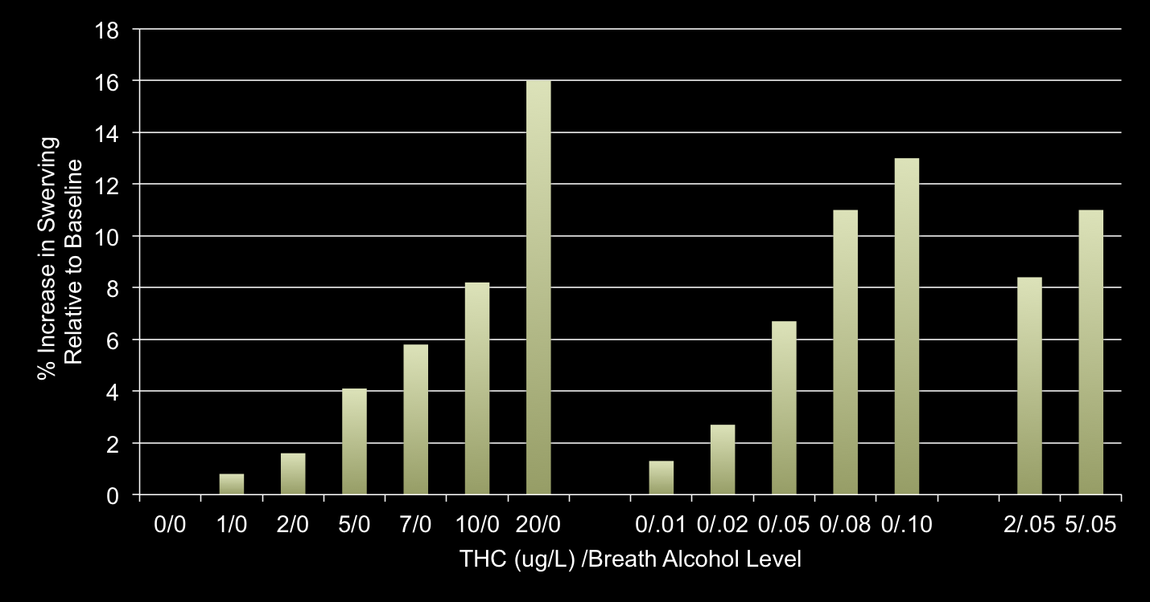
Cannabis blood levels/Breath alcohol level and simulator swerving
THC Only Alcohol Only Combined
Hartman et al., 2015
Notes:
N=18 “occasional” users (>=1x/last 3 months, < 3 days/week); 21-37 yo
500mg 2.9% or 6.7% THC (vaporized)
50 minute drive
Blood collected after the drive (1.4h and 2.3h after smoking)
THC of 8.2 and 13.1 ug/L increased SDLP similar to .05 and 008 g/210L brAlc (most common legal limites)

Slide 4
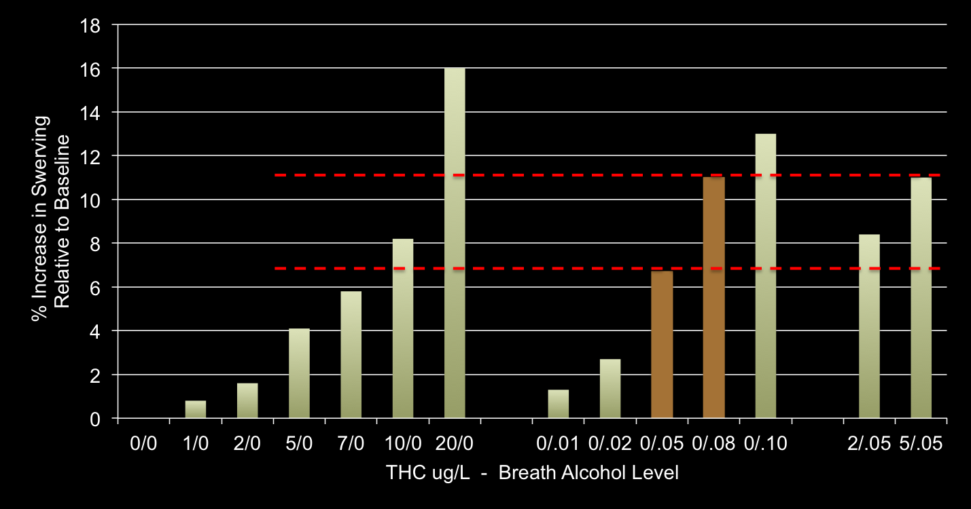
Cannabis blood levels/Breath alcohol level and simulator swerving
THC Only Alcohol Only Combined
Hartman et al., 2015
Notes:
N=18 “occasional” users (>=1x/last 3 months, < 3 days/week); 21-37 yo
500mg 2.9% or 6.7% THC (vaporized)
50 minute drive
Blood collected after the drive (1.4h and 2.3h after smoking)
THC of 8.2 and 13.1 ug/L increased SDLP similar to .05 and 008 g/210L brAlc (most common legal limites)

Slide 5
THC levels are elevated by concurrent alcohol use
32 moderate cannabis users; crossover design (19 completers)
Placebo or low-dose alcohol (target .065% BrAC)
Then Vaporize placebo, 2.9% or 6.7% THC cannabis
THC Maximum Concentration (C_{max})
Alcohol pretreatment significantly decreased latency to smoked-cannabis effects and increased euphoria duration (Hartman et al, 2015)
Hartman et al., 2015

Slide 6
Canada per se law (Bill C-46)
THC in blood (within 2 hours of driving)
  2-5 ng Fine up to $1,000
  >5 ng Same as alcohol-impaired driving
  1st offence - Minimum $1,000
  2nd offence - 30 days prison
  3rd offence - 120 days prison
  > 2.5ng + >.05 BAC Same as above
Roadside test can be required for any driver: No reasonable suspicion required
Roadside saliva testing: Need reasonable suspicion
Notes:
BAC - Blood alcohol concentration

Slide 7
Background
Lack of systematic research on the relationship between cannabis and alcohol use, driving impairment, and SFST/DRE evaluations
The few studies that have been conducted have numerous limitations:
  Assessing only select components of the SFSTs (OLS, WAT, HGN)
  Only including “heavy” users, so tolerance is likely
  Small sample sizes
  Using low-dose cannabis (1.8%, 3.0%, or only ~ 32mg in adult [vs. ~90mg in 13% joint])
Conducting the initial SFSTs 2 hours after smoking, when peak impairment is declining
Exposing participants to SFSTs prior to the treatment

Slide 8
Study Questions
How does the consumption of cannabis and alcohol affect driving performance? What is the relationship between time since consumption and impairment?
Does the presence of alcohol modify THC levels in various fluids? What is the relationship between driving performance and THC/BrAC levels in blood, oral fluid, and breath?
How accurately do officers trained on the DRE assessment identify the presence of cannabis and alcohol? How accurately do they classify drivers as impaired versus unimpaired (based upon simulator performance)?

Slide 9
Study Design
Randomized controlled trial
Parallel design with healthy participants
Randomize to:
  Cannabis (~13%; placebo)
  Alcohol (placebo, < .05, .08 [possibly smaller samples in placebo, > 08])
Driving Simulations
  Pre, and 2 post simulations
Fluid draws (blood, OF, breath)
Multiple DREs
  Independent evaluation of impairment at different timepoints
  Collect data on additional psychophysical tests which were not performed during AB266 because of the time constraints
iPad-based assessments

Slide 10
Study Design
Screening
Pre-evaluation Visit
  Drug screening, psychiatric/medical confounds, simulator training
Evaluation Day
  Multiple participants
  Staggered arrival (mask when then drank/smoke)
  Drug administration
    Fluids and BrAC drawn prior to treatment
    Drink alcohol in order to reach the target BrAC (vodka + OJ)

Slide 11
Drug Recognition Expert (DRE) Evaluation
At Detention Facility
Breath alcohol test
DRE Interview of arresting officer
Preliminary exam and first pulse
Eye examination (HGN, VGN, lack of convergence)
Divided attention psychophysical tests (modified Romberg Balance, walk and turn, one-leg stand, finger to nose)
Vital signs (blood pressure, body temp, second pulse)
Dark room exam (pupil size/response)
Muscle tone exam
Check for injection sites, third pulse
Interview of suspect
Analysis and opinions of the evaluator
Toxicological Exam

Slide 12
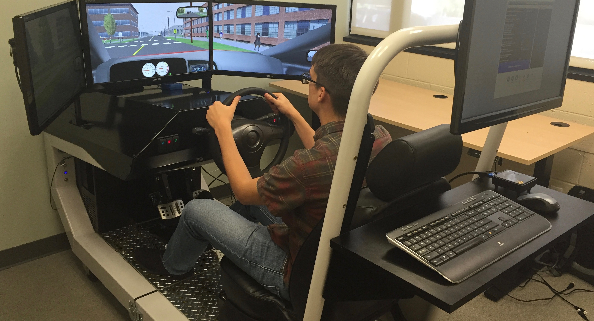
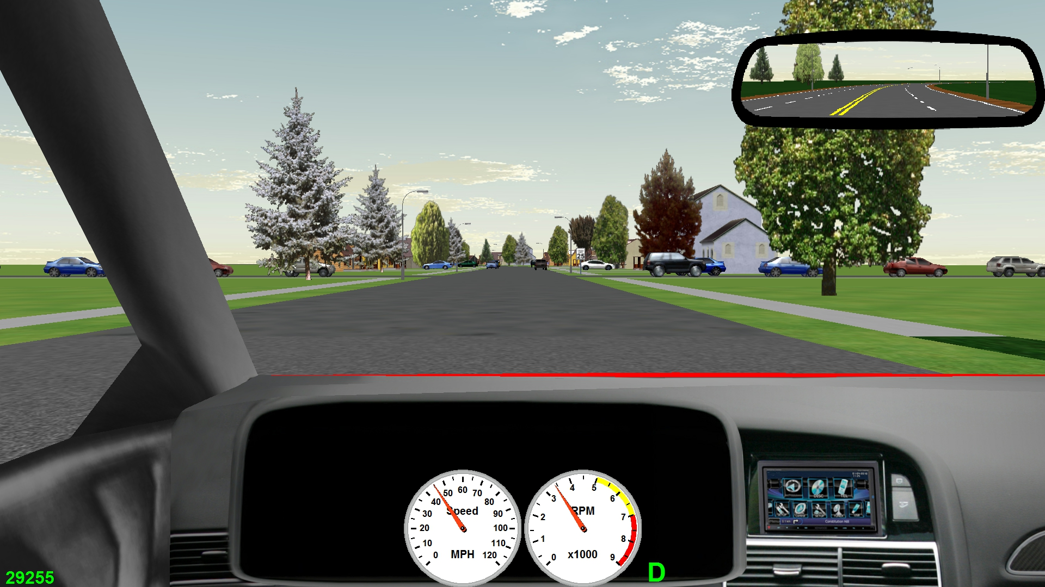
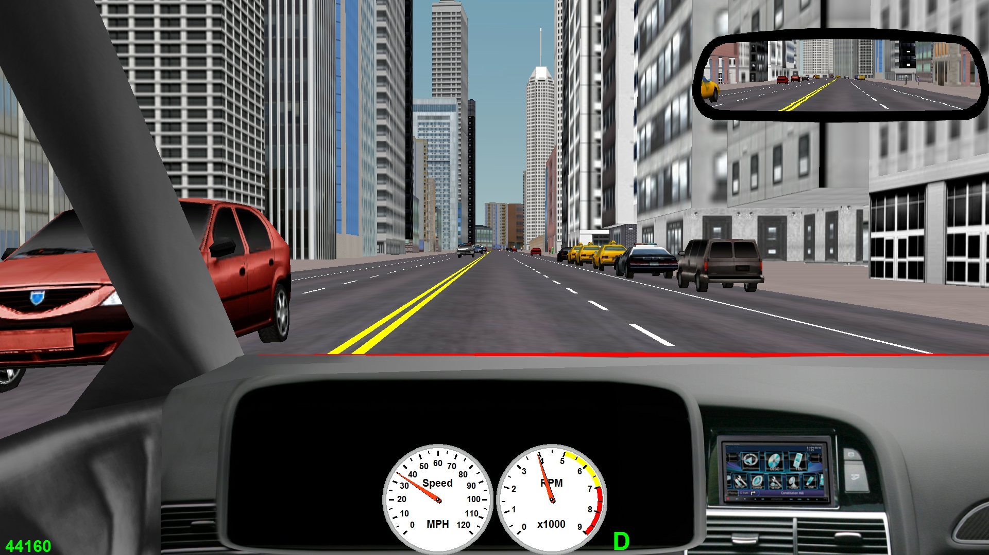
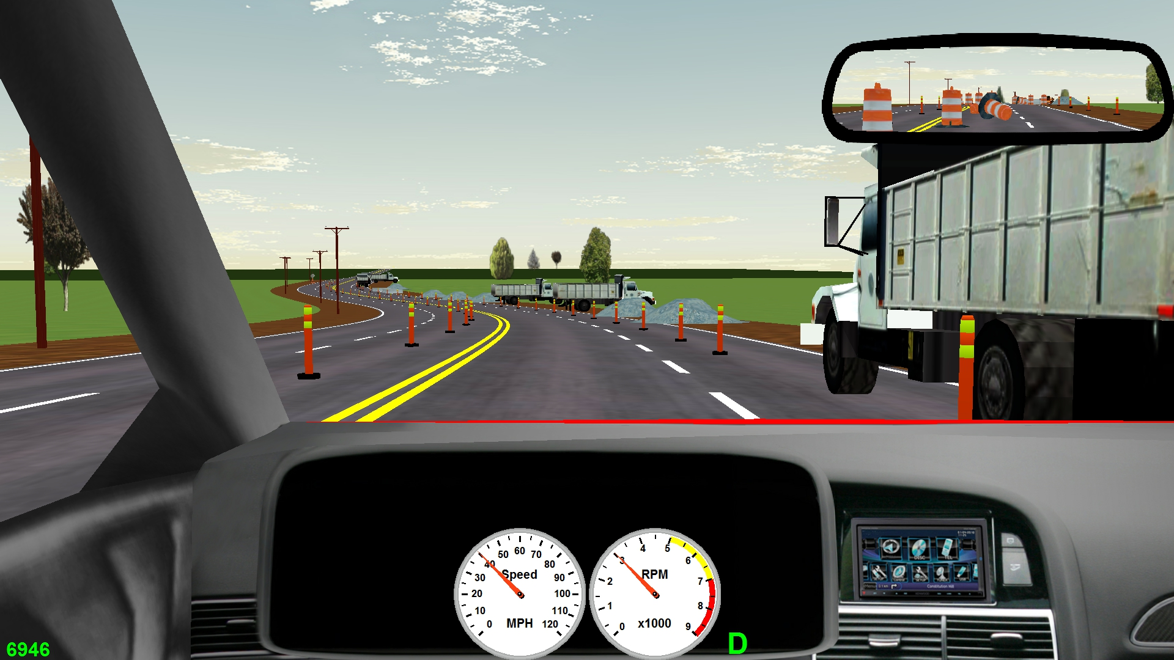
Driving simulator

Slide 13
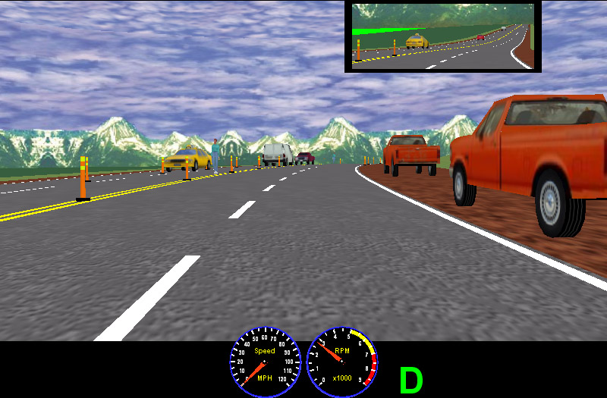
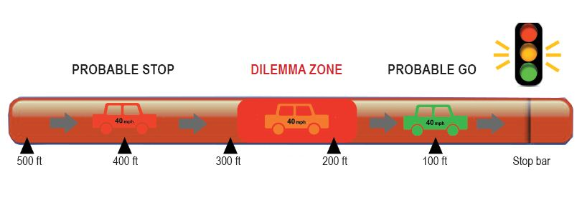
Simulations
Divided attention/multi-tasking, reaction time, time/distance perception
  Left hand turn across traffic (gap acceptance)
  Yellow light dilemma
  Freeway merging, off ramp
  Crash avoidance

Slide 14
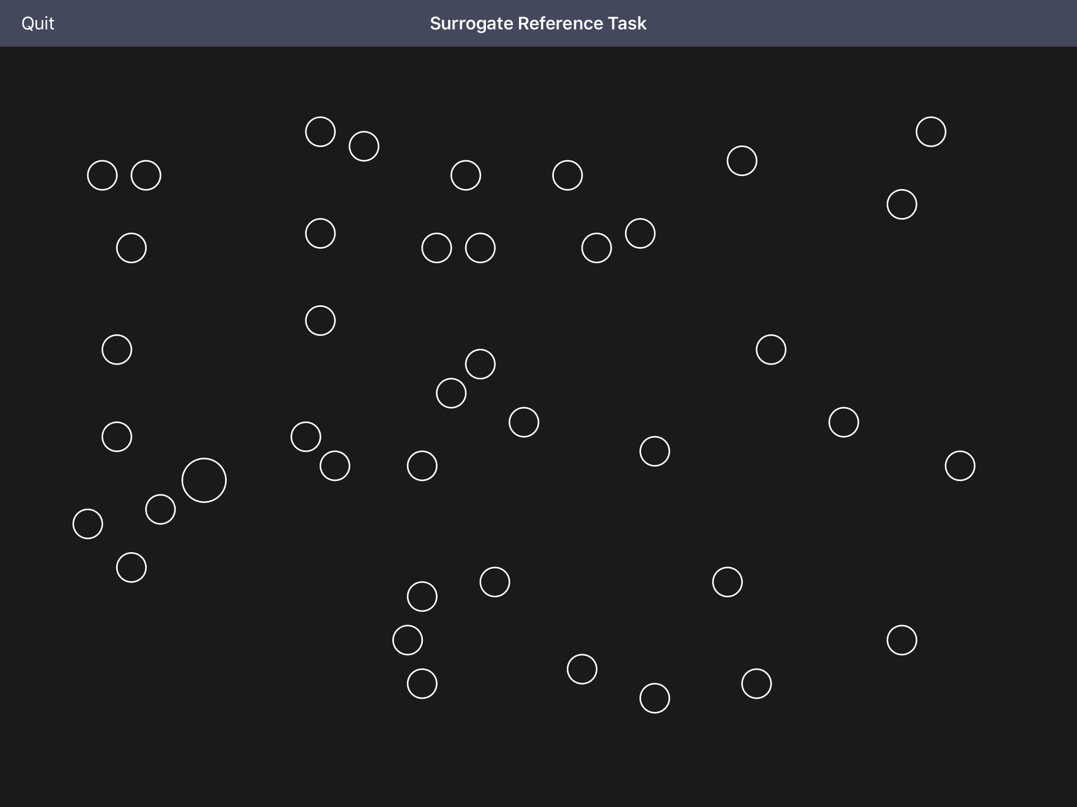
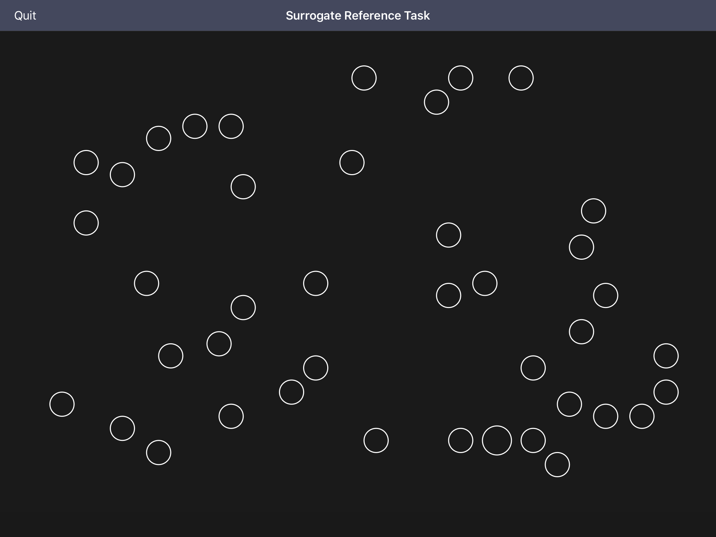
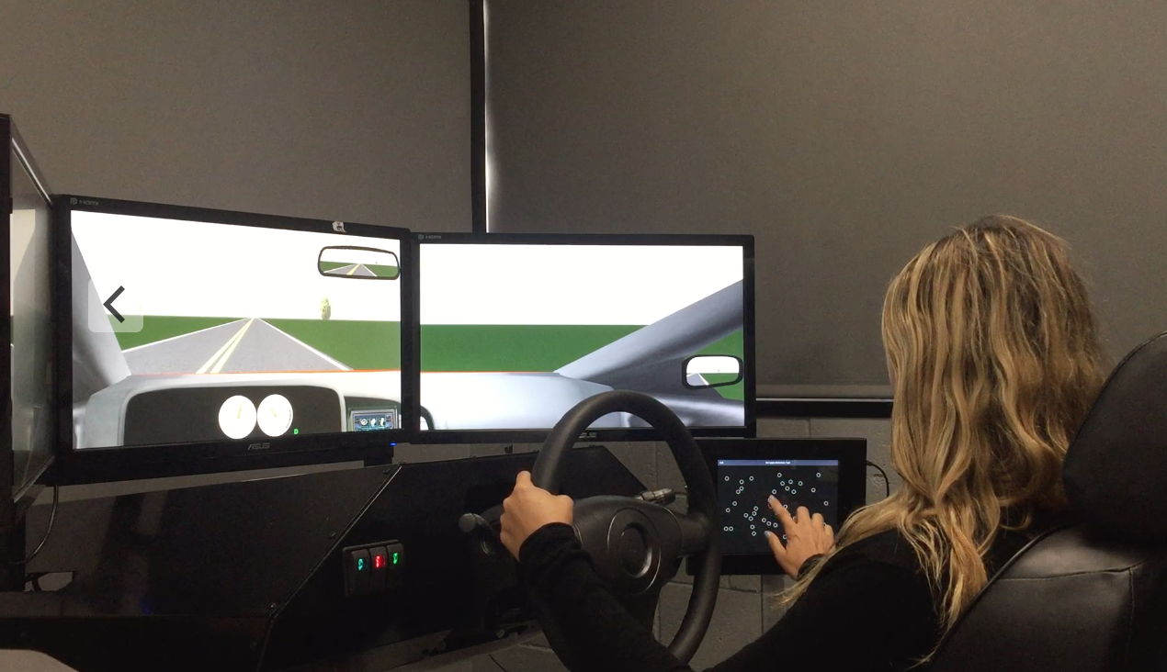
Driving Simulation Scenarios –
Distracted Driving/Multi-tasking
  Identify circle that is different than others
  Two levels of difficulty
  Response time and accuracy
  Driving performance prior to/during task
    Standard deviation of lateral position (SDLP) – swerving
    Speed deviation

Slide 15
The Effects of Cannabis and Alcohol on Driving Performance, and the Detection of Impairment
Thomas D. Marcotte, PhD
Robert Fitzgerald, PhD
Center for Medicinal Cannabis Research (CMCR)
University of California, San Diego

