Slide 1
Cannabis consumption and driving impairment assessment on a closed course: A research proposal
Mark C. Fox, Ph.D.
June 5, 2019

Slide 2
Cannabis and driving in California
Cannabis, now legal for recreational use in California, affects driving.
Officers need to be able to detect cannabis-impaired driving.
CHP: How well do existing behavioral tests of impairment such as the SFST (Standard Field Sobriety Tests) detect cannabis impairment?

Slide 3
Background
Cannabis vs. alcohol.
Detecting impairment vs. detecting consumption of a substance (including being under the influence).
Limited applicability of existing research.

Slide 4
The alcohol model of impairment
We know that alcohol impairs driving; the more alcohol, the more impairment.
We can use empirical evidence about alcohol impairment and driving to inform the choice of a per se limit.
This appears so obvious that we may assume we could apply it to every drug.

Slide 5
The alcohol model of impairment
Implicit assumptions that happen to be true for alcohol:
  There is one and only one psychoactive substance.
  This substance has a dose-dependent effect on driving that is relatively uniform across persons.
  The magnitude of this effect co-varies almost perfectly with the quantity of the substance in the body over time.

Slide 6
Applying the same model to cannabis
  The “substance” called cannabis has multiple psychoactive compounds that differ in ratios across products.
  Even Δ⁹-Tetrahydrocannibinol (THC) in isolation may have more variable effects than alcohol from person to person.
  These effects seem to co-vary much less (compared to alcohol) with quantities in the body over time.

Slide 7
Establishing cannabis impairment
A per se law for cannabis (e.g., for THC) would likely be invalid (and unfair) given what we know (at least compared to the per se law for alcohol).
There may be no measurable chemical or physiological proxy for cannabis impairment that is sufficiently valid.

Slide 8
Establishing cannabis impairment
Relying on a behavioral standard -- e.g., the SFST and the behavioral components of the Drug Recognition Expert (DRE) evaluation -- may be unavoidable.
This standard must distinguish impairment from mere consumption.

Slide 9
Distinguishing impairment from consumption (legally)
Commonwealth v. Gerhardt (2017): Massachusetts law requires evidence of both:
  being under the influence of a substance…
  …and that being under the influence of this substance hindered the ability to drive safely (i.e., impairment).

Slide 10
Distinguishing impairment from consumption (scientifically)
For law enforcement, the question is whether SFSTs detect impairment, not how sensitive they are to consumption or presence of a substance.
Statistically, this is a signal detection problem (impaired vs. not impaired), not a correlational one.
Validation will require some independent and non-arbitrary standard for impairment.

Slide 11
Limited applicability of previous research
Existing research examines effects of cannabis on SFST scores.
This relates SFST scores with cannabis consumption (e.g., THC levels of blood) rather than the test’s accuracy at detecting impairment.
No independent standard for impairment.
Insufficient statistical power for detecting behavioral effects (i.e., very small samples).

Slide 12
An impairment standard for validation of SFSTs
A modified version of the Driver Performance Evaluation that must be passed by every California driver (MDPE)
  Failing this test will be treated as the definition of impairment when evaluating SFST accuracy.
  Non-arbitrary, as it is derived from the very test that determines whether one is fit to drive in California.
  Modified to be completed on a limited closed course in the absence of other traffic.

Slide 13
Other important design features
True experiment with random assignment
  Cannabis, placebo, and control (with smoked vs. edible varied but not manipulated).
  Time between peak effect and driving (0, 30, or 60 minutes).
  Causal inference: we can infer that differences in driving are due to cannabis and the length of time following its consumption before driving.

Slide 14
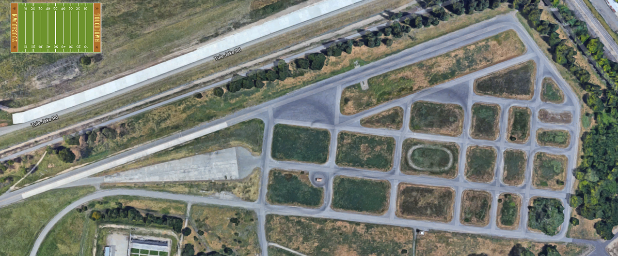
Other important design features
Actual driving within a closed-course environment (realism/external validity).

Slide 15
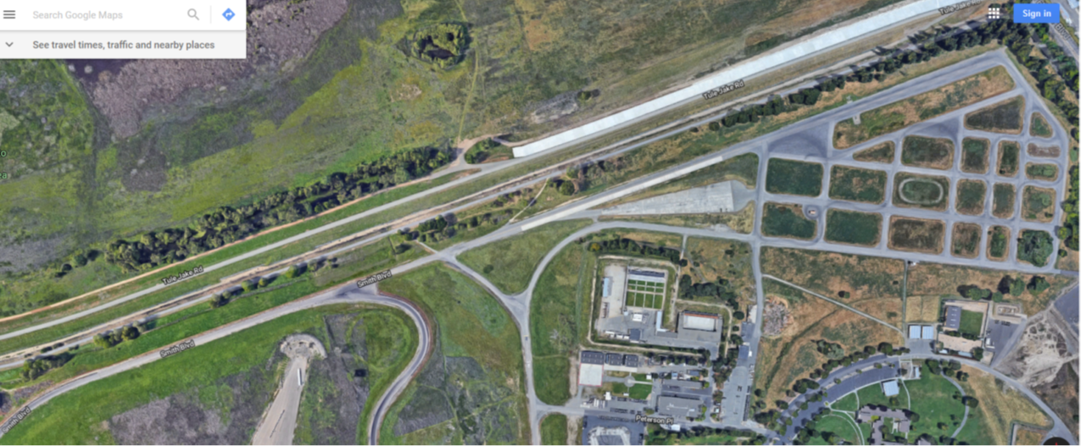
Other important design features
Actual driving within a closed-course environment (realism/external validity)

Slide 16
Other important design features
Very large sample of drivers (n ≈ 500)
  Needed to validate behavioral instruments.
  Improves the likelihood of detecting even small effects of cannabis.
  If no effects are observed, we can be more confident that the population effects are indeed very small (i.e., our results are not a “fluke”).

Slide 17
Other important design features
Between-subjects design (every driver participates in only one condition per independent variable)
  Minimizes practice and learning effects
  Law enforcement application prioritizes generalizability over specificity: few observations from many people are better than many observations from few people.

Slide 18
Overview of the procedure
The driver consumes cannabis, placebo, or nothing.
Following assigned time course, the driver takes the MDPE and other driving tests.
An officer attempts to determine if the driver is impaired in two ways:
  Observing driving itself while following
  Conducting a DRE evaluation (which includes the SFST).

Slide 19
Some additional features
Inclusive sampling of cannabis-using drivers
Multiple blood samples are collected.
Study sessions are conducted at night for added realism.
Driving variables range from basic vehicle control (variation in lane position and speed) to complex attention and memory tasks.

Slide 20
When random effects are treated as fixed
An effect that likely varies outside of a study (a “random” effect) is treated as invariant (or “fixed”) within the study.
Pervades social science research
Often a practical necessity
  We have only one closed course to work with.
  We have only one type of cannabis to work with.

Slide 21
When random effects are treated as fixed
Limits our ability to generalize findings beyond the study
We can still generalize to the extent that we believe the fixed effect approximates the highest frequency effects.
No study is perfect; one with a less-than-representative fixed effect is MUCH better than no study.

Slide 22
If all goes according to plan…
A sense of how accurately officer observations of driving and SFSTs identify legal impairment.
Further, albeit limited, assessment of the DRE evaluation (when cannabis is the only drug).
A very rare dataset reflecting the effects of cannabis on naturalistic (i.e., not a simulator) driving in a large sample of California drivers.

Slide 23
Questions?
With many thanks to our colleagues at CHP, for sponsoring this project, and
With thanks to our proposed collaborators at UCSD-CMCR.
DMV team:
Mark C. Fox, Ph.D.; Ainsley L. Mitchum, Ph.D.; Steven Villafranca, M.A.; Dario Sacchi, Ph.D.; and Bayliss J. Camp, Ph.D. (and others)

