Slide 1
Performance-Based DUI Testing
By Dale Gieringer, Ph.D.
Director, Cal NORML
www.canorml.org
CHP Drug DUI Task Force Presentation
Sacramento, Oct 14, 2019

Slide 2

Impairment Testing Concerns
No breathalyzer test equivalent for THC (or other drugs)
THC blood (or saliva or urine) levels not predictive of measured impairment
NHTSA (2016): “It is difficult to establish a relationship between a person's THC blood or plasma concentration and performance impairing effects”
NHTSA (2017): Per se blood tests limits for cannabis “are not evidence-based”
Congressional Research Service (2019): “no reliable test to indicate impairment from marijuana”
Dr. Marilyn Huestis (ex-NIDA): "There is no one blood or oral fluid concentration that can differentiate impaired and not impaired”

Slide 3
Impairing Effects of THC
Speed & distance variability (Robbe 1994 )
Lane tracking (Smiley 1999)
Peripheral Vision (Moskowitz, 1972)
Balance (Bondallaz et al., 2016)
Reaction Time (esp. complex) (Ramaekers 2006)
Divided attention tasks (Anderson et al 2010)
Getting lost
Slower, more cautious driving (Smiley1999)
Tolerance in chronic users (Hart 2001, Ramaekers 2011)

Slide 4
Detection Methods
Drug Recognition Experts
Standard Field Sobriety Test (SFST)
Walk and turn (WAT)
One leg standing (OLS)
Horizontal gaze nystagmus (HGN)
Studies:
Bosker et al. 2011:
OLS “Mildly sensitive” to THC in heavy users:
Papafotiou 2005:
WAT & OLS sensitive to THC in occasional users;
not HGN; but head movements or jerks (HMJ)

Slide 5
Computer App Impairment Tests
Measure performance, not body chemistry
Non-invasive
Inexpensive
Not drug-specific
Individual baselines vary

Slide 6
Developmental Status
Workplace performance tests - in use
(Bowles-Langley Tech, Predictive Safety)
Driving tests - under development
(DRUID®, U Chicago, Omiga®, Visulyzer®, et al.)

Slide 7
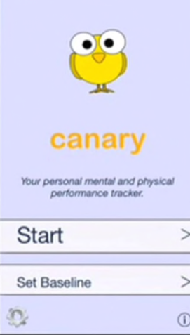
MyCanary app *
Developed for self-evaluation
of cannabis-using drivers
Tests:
6-Digit Memory
Finger tracking reaction
Time estimation (20 sec)
One leg standing balance
*(No longer on market)

