Slide 1

Testing Cannabis Impairment with the DRUID® App—Proof of Concept
Michael Milburn, Ph.D. Ryan Vandrey, Ph.D.
Founder, CSO Behavioral Pharmacology
DRUIDapp, Inc. Johns Hopkins Medical Institute
Presentation for NIDA, Neuroscience and Behavior Division
September 20, 2019
Presentation adapted for the California Highway Patrol Task Force on Impaired Driving by Dr. Nicholas Lovrich, Regents Professor Emeritus, Department of Criminal Justice and Criminology, Washington State University (Oct. 14th, 2019)

Slide 2
DISCLAIMER
Lovrich Background in Evaluation Research: 33 years (1977-2010) as the Director of the WSU Division of Governmental Studies & Services. PI or Co-PI on grants totally $16+ million, with supervision of 30 PhD dissertations. Major client agency was WSP
MY CURRENT AFFILIATIONS:
Washington State University
            School of Politics, Philosophy and Public Affairs, Claudius O. and Mary W. Johnson Distinguished Professor of Political Science (Emeritus)
            Department of Criminal Justice and Criminology, Research Faculty
          Oregon State University
            Affiliate Graduate Faculty, School of Public Policy
          University of Utah
            Affiliate Researcher, Department of Political Science
No formal affiliation with DRUID. Interested in using it in research, and in the context of cannabis-impaired driving and boating enforcement, police training on cannabis impairment, and workplace safety applications

Slide 3
SBIR Phase I Results; Phase II Decision Pending on $1.7 million award made in 2018
Drug-impaired performance of complex tasks risks is well documented
Alcohol Impairment
Largest effect sizes for impaired balance (eyes open), slower reaction time with divided-attention, and psychomotor vigilance tasks (Jongen et al., 2014)
Poorer stability and balance, a key element of Standardized Field Sobriety Test [SFST] (Downey et al., 2016)
Cannabis Impairment (less research, but sufficient to establish risk)
Impaired balance (Bondallaz et al., 2016)
Slower reaction time (Hunault et al., 2009; Lenne et al., 2010; Heustis, 2016 )
Poorer coordination (Heustis, 2016)
Worsened performance on divided-attention tasks (Anderson et al., 2010)
Reduced attention to motor stimuli (Mikulskaya & Martin, 2018)
Impaired hand-eye coordination (Moskowitz, 1985)

Slide 4
SBIR RFP: Impairment Assessment Concerns
No breathalyzer test equivalent for THC, AND
THC blood levels not predictive of measured impairment
NHTSA (2016): “It is difficult to establish a relationship between a person's THC blood or plasma concentration and performance impairing effects” [Problem with blood as ‘gold standard evidence’]
NHTSA (2017): Per se blood tests limits for cannabis “are not evidence-based” [Problem with existing DUI laws & per se statutes]
Congressional Research Service (2019): “no reliable test to indicate impairment from marijuana”

Slide 5

How DRUID® Works
Driving impairment literature →
Four Tasks (3 Divided Attention), measuring:
  Reaction Time
  Decision Making
  Object Tracking--Hand/Eye Coordination
  Time Estimation
  Balance
DRUID test takes 2 minutes to complete
Available for all iOS or Android platforms (phones and tablets)
Using proprietory software, DRUID® uses an evidence-based algorithm that calculates a Total Impairment Score (varies mostly from 30 to 70)

Slide 6
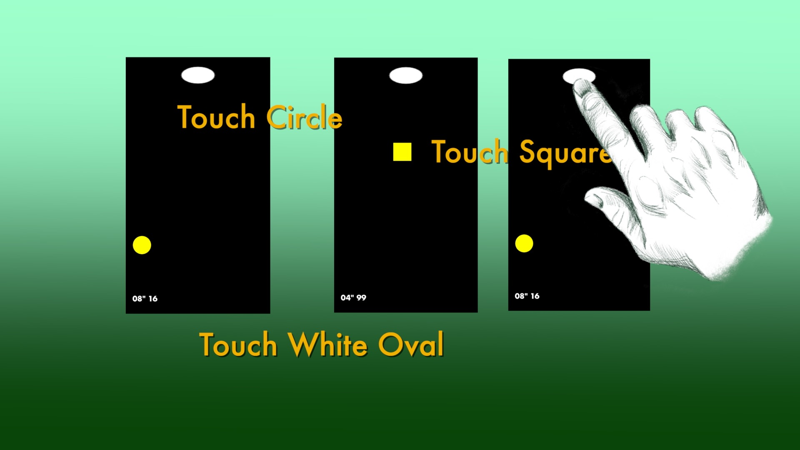
Task 1
Decision-making and Reaction Time (DAT)

Slide 7
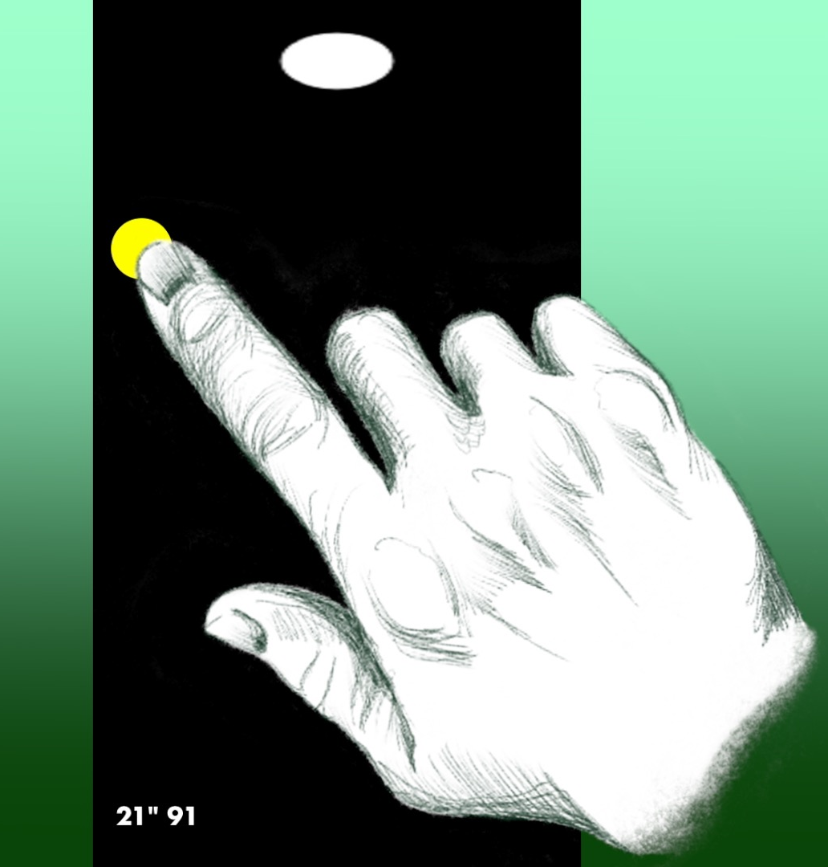
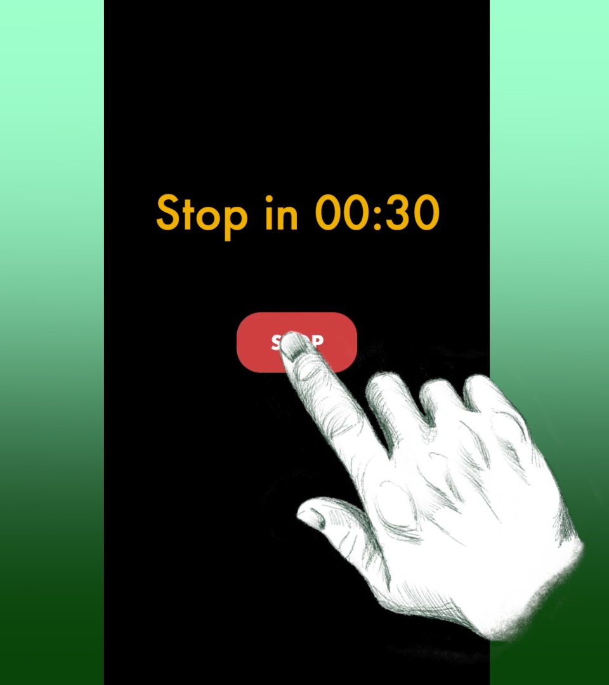

Task 2
Time Estimation and Reaction Time (DAT)

Slide 8

Task 3
Hand-eye coordination (DAT)
Follow the moving white circle and

Slide 9
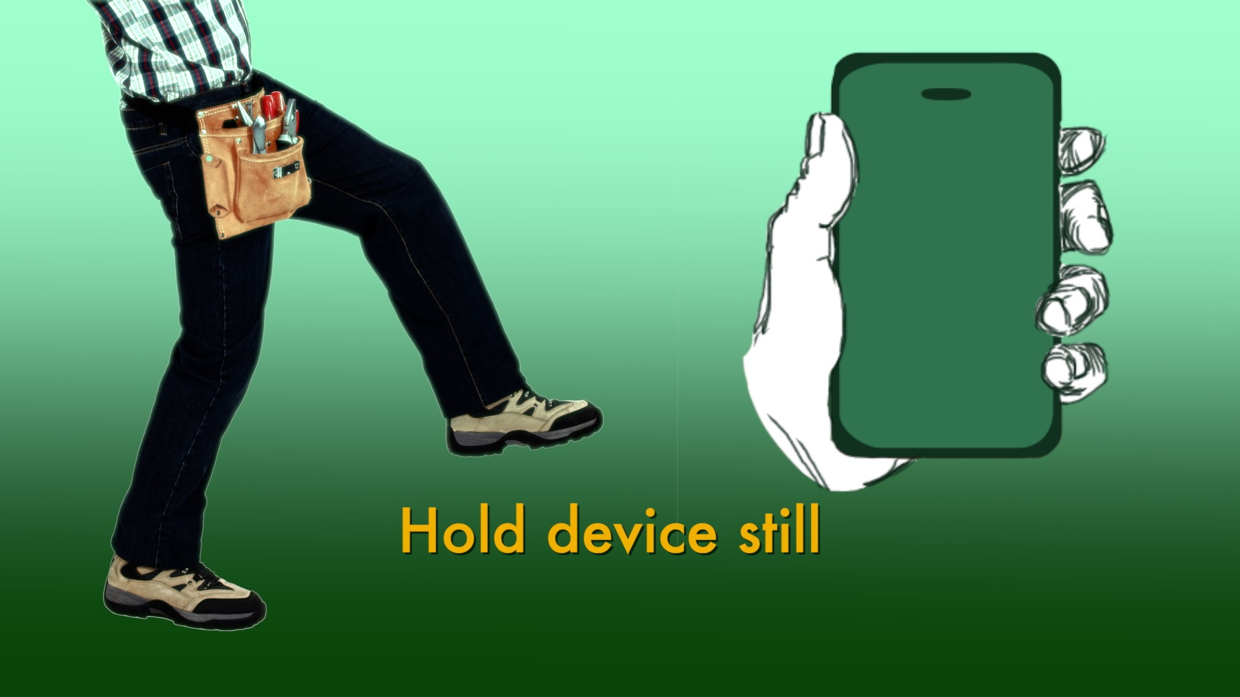
Task 4
Balance

Slide 10
Pre-SBIR Research: Grant Application Pilot Testing Evidence Collected
Over-time measurement done
Reliability of scores testing done
Calibration across platforms done
Alcohol impairment testing done
Cannabis impairment testing done

Slide 11
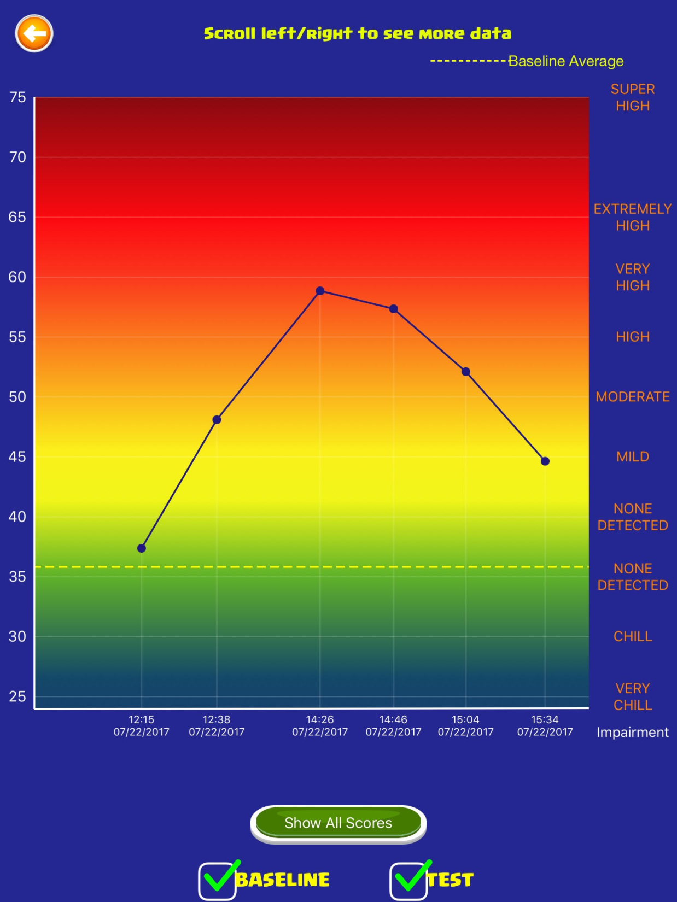
DRUID®
Graphic Results Display
Impairment score 30-70
Higher score = Greater impairment

Slide 12
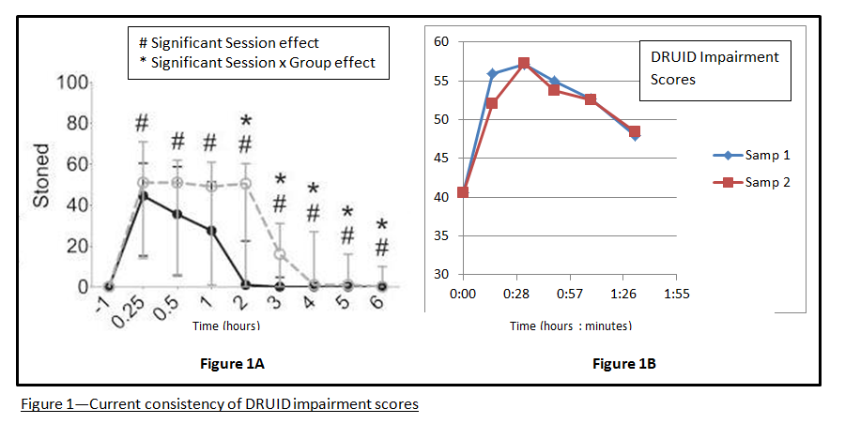
DRUID® Reliability Assessing
Cannabis Impairment
DRUID® Impairment Scores from same participant, vaporizing two samples (.4 gm) from the same batch of marijuana on two successive days

Slide 13
DRUID® Database Results for
Documenting Cannabis Impairment
10,000+ individual uses of DRUID® saved to Database
Average DRUID® Total Impairment Scores calculated, both before and after cannabis use
Consistently statistically significant differences noted between baseline and post-cannabis use scores

Slide 14
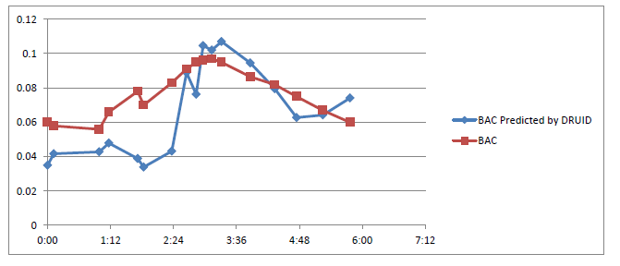
DRUID® Impairment Scores and Blood Alcohol Concentration
r = .86
Estimated BAC
BAC
TIME
DRUID® and BacTrak Breathalyzer done repeatedly in close succession over a three-hour period

Slide 15
Massachusetts
Regional Municipal Police Academy Data
MA is one of 15 states that uses “Wet Labs” to train and certify cadets in the Standardized Field Sobriety Test
Volunteers recruited to drink alcohol to a BAC > 0.08% — then stopped drinking
Milburn collected DRUID® scores when volunteers were sober and when BAC > 0.08% documented

Slide 16
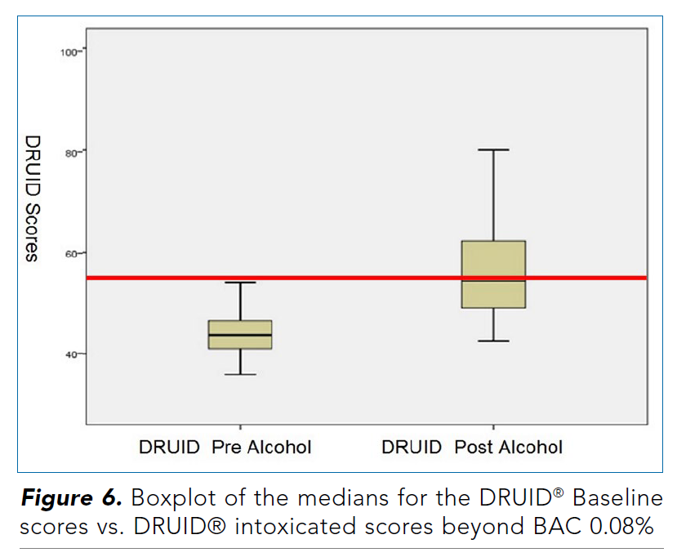
DRUID® Alcohol Impairment Results
Massachusetts Regional Municipal Police Academys
[Randolph&Plymouth]
Difference highly statistically significant
(t₍₄₇₎ = 8.68, p < .0001).
Richman, J.E., & May, S. (2019). An investigation of the DRUID® Smartphone/Tablet App as a Rapid Screening Assessment for Cognitive and Psychomotor Impairment Associated with Alcohol Intoxication. Vision Development and Rehabilitation, 5, 31-42.

Slide 17
DRUID® and Alcohol Impairment Results
DRUID® is very effective in identifying impairment from alcohol
  Minimal false positives
These findings from law enforcement training settings enable:
  Identification of a consistent standard of impairment
  Calibration of DRUID® to the per se (limit % BAC) that defines alcohol-impaired driving in a particular state [generally .08; .05 in Utah as of 2019]

Slide 18
SBIR Grant—Subaward made to:
Dr. Ryan Vandrey [DEA-licensed researcher]
Division of Behavioral Pharmacology medical institute
Johns Hopkins University
SBIR Phase I Validation Research

Slide 19
SBIR Phase I Vandrey Lab Milestones
M1:
Show significant difference in DRUID App scores after high-dose oral and vaporized cannabis exposure (sensitivity and reliability)
M2:
Show no change after placebo administration (specificity/stability)
M3:
Show correspondence between DRUID scores and other accepted measures of elements of cognitive and psycho-motor impairment

Slide 20
Study Design Overview
Within-subject crossover design laboratory study (Subjects: 20 infrequent cannabis users*).
  6 outpatient cannabis administration sessions (completed in randomized order).
  3 oral cannabis sessions: (0, 10, 25 mg THC).
  3 vaporized cannabis sessions:(0, 5, 20 mg THC).
  *10 males and 10 females; mean age 28.5; mean
  BMI 25; half caucasian and half minority
Notes:
These doses were informed based on our previous studies. Essentially for each of these routes of administration, we wanted a low dose that we knew would produce perceptible drug effects but that would not cause impairment (analogous to someone having 1 or 2 beers but still not being functionally impaired) and a high dose that we knew would produce stronger drug effects and more pronounced impairment that would negatively impact driving ability.

Slide 21
Outcome Measures
Subjective Drug Effects:
  VAS scores (0-100) on Drug Effect Questionnaire.
Battery of Cognitive/Psychomotor Performance Assessments:
  (1) Digit Symbol Substitution Task (DSST); (2) Paced Serial Addition Task (PSAT); (3) Divided Attention Task (DAT); (4) DRUID® IOS application.
Field Sobriety Tests – Core Elements of the SFST:
  (1) Horizontal gaze nystagmus; (2) Lack of eye convergence; (3) Pupillary response to light; (4) Walk and turn; (5) One-leg stand; (6) Modified Romberg balance.

Slide 22
Subjective Drug Effects
Oral Cannabis
Vaped Cannabis

Slide 23
Aim 1: Stability and Accuracy of DRUID
Oral Cannabis
Vaped Cannabis

Slide 24
DRUID: Peak Global Impairment Scores Post-Cannabis Administration Showing Dose Sensitivity & Impact of Vaped Intake
58=BAC of .08

Slide 25
Aim 2: Establish Efficacy
M3:
Show significant correlation between DRUID App scores and outcomes of other cognitive assessments of impairment
 |  | Self-reported difficulty completing tasks | DSST # attempted | Divided Attention Distance | PASAT Total Correct
DRUID Score: High Dose Oral Cannabis (25mg THC) | Pearson Correlation |  | .202** | -.367** | .331** | -.534**
 | Sig. (2-tailed) |  | 0.007 | 0.000 | 0.000 | 0.000
 | N |  | 179 | 179 | 179 | 179
DRUID Score: High Dose Vaped Cannabis (20mg THC) | Pearson Correlation |  | .148* | -.252** | .216** | -.335**
 | Sig. (2-tailed) |  | 0.050 | 0.001 | 0.004 | 0.000
 | N |  | 177 | 177 | 176 | 177

Slide 26
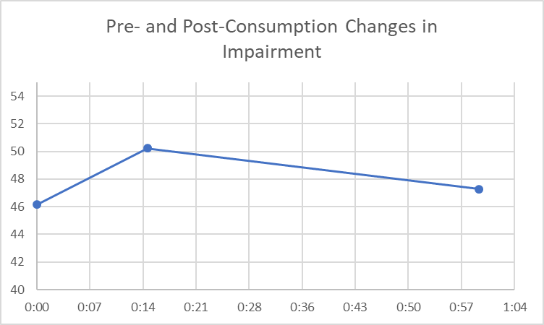
Dr. Cinnamon Bidwell, University of Colorado
Study of 75 High Tolerance Population with DRUID
“CannaVan” used to collect data on frequent (4x per week or more) cannabis users at their homes
Followed 75 participants for one hour after starting to consume
Significant linear and quadradic effects for DRUID impairment scores

Slide 27
Washington Police Training Assessment and
Daily Users Studies
1. Washington State University Collaboration (3 elements)
  Clowers and Lovrich studies on detection of acute recent THC exposure (DSHS-funded – involved use of Ion Mobility Spectrometry to test breath & oral fluids).
  WTSC-funded study with 50 subjects, 3 Pullman PD ADIRE-trained officers, and 3 sets of subjects: 20 occasional and 20 chronic users; 10 “confederates” [never used]. RESULTS: Enhanced ARIDE assessments of occasional users had few false negatives; with chronic users, however, high rate of false negatives; with older confederates, a high rate of false positives – none were impaired. Officers’ interest in using DRUID very high. [Data: blood, oral fluids & SFST data]
  Three-year National Institute of Justice grant to study the impact of legalization of marijuana on crime and policing [$1 million]; one focus, DUI and DRE/ARIDE
  Observation and data collection in “green labs” for police training on cannabis impairment detection [Washington Traffic Safety Commission and Washington State Parks agency support – volunteers provided by The Cannabis Alliance]

Slide 28
Washington Police Training Assessment and Daily Users Studies
2. 39 Daily cannabis users were recruited by the AIMS Institute (Seattle cannabis-prescribing medical practice) and The Cannabis Alliance (largest association of Washington licensed growers/processors)
SETTING: Subjects consumed in usual manner (e.g., smoke flower in joint, smoke cannabis material in water pipe, vape) what is for them a typical amount of high-potency cannabis used for treatment of conditions and/or recreational high.
Researchers observed behavior, interviewed subjects, and tested (blood pressure, heart rate and DRUID) for 2½ hours, using DRUID® every 30 min.

Slide 29
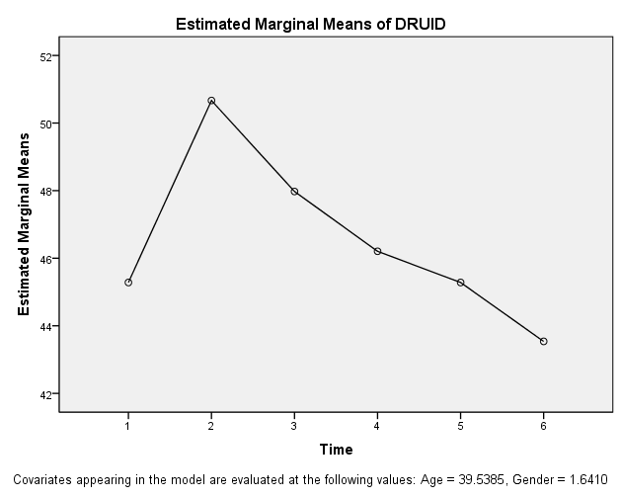
Washington Frequent Users Study Results: After 90 Minutes Chronic Users are Nearly Back to Baseline
39 Daily cannabis users recruited by Cannabis Alliance and medical cannabis office
Vaped or smoked 1 gm “green crack” or similar high-THC cannabis
Collected DRUID data for 2 1/2 hours after starting to consume
0 0:30 1:00 1:30 2:00 2:30

Slide 30

GRAND SUMMARY:
Mean DRUID® Scores
Richman & May (2019) BAC > .08
Vandrey—20mg THC light cannabis uses
Milburn—(WA) frequent cannabis users
Bidwell—(CO) frequent cannabis users
Milburn/Bidwell frequent users after 1 hour
Vandrey—5 mg THC light cannabis uses
Milburn frequent users after 2 1/2 hours

Slide 31
DRUID® is becoming the Gold Standard for
Impairment Evaluation in Neuroscience
A tool for neuroscience researchers to map CB1 receptor activity, or document cognitive or psycho-motor impairment from other sources; currently being used by researchers at major universities across the U.S.:
Johns Hopkins University
Brown University
Yale University
University of Colorado at Boulder
University of Kentucky
Washington State University and University of Washington

Slide 32
In Conclusion
DRUID®
Provides a tool to assess impairment from a variety of causes
Has multiple applications in
  Industrial /Manufacturing/Construction workplace safety
  Transportation and fleet operations remote vehicle operation safety
  Military training limits/fitness for duty and drug use monitoring
  Doctors prescribing of medications and concussion testing in sports medicine
IN LAW ENFORCEMENT: Effective enforcement of drug-impaired driving statutes; training of DRE and ARIDE officers
FEASABILITY OF ENHANCEMENT OF SFST AND ARIDE TRAINING WITH “GREEN LAB” COMPONENT, USING DRUID TO ENSURE THE SAFE PARTICIPATION OF CANNABIS-CONSUMING VOLUNTEERS

Slide 33
THANK YOU
CONTACT INFORMATION
Dr. Nicholas Lovrich, Regents Professor Emeritus
School of Politics, Philosophy & Public Affairs
Washington State University
n.lovrich@wsu.edu

